Slide 1



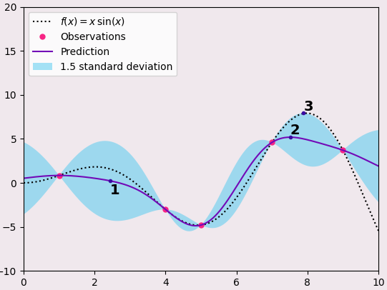
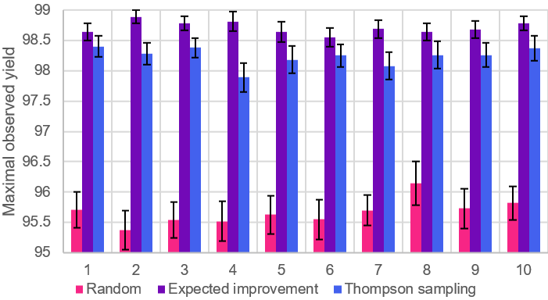



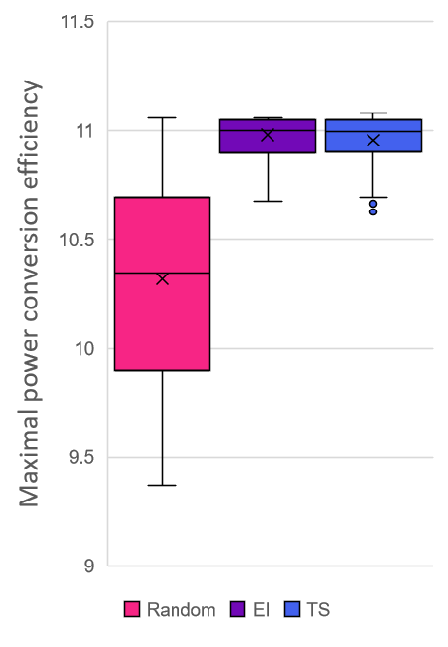
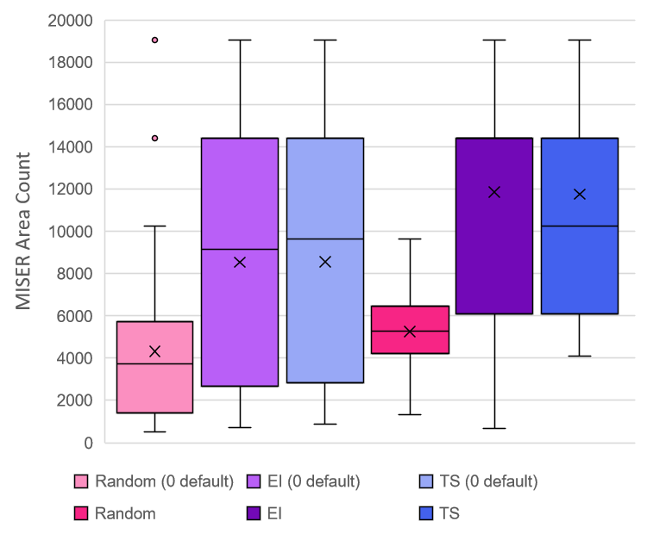
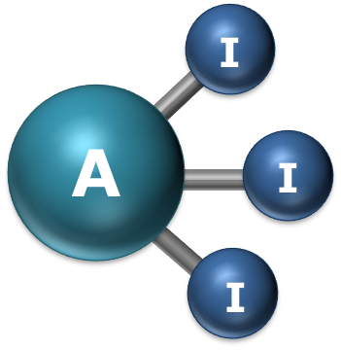


Bayesian optimisation in Chemistry
Rubaiyat Khondaker¹, Stephen Gow², Mahesan Niranjan³, Jeremy Frey²
¹Department of Mathematics, University of Cambridge; ²Department of Chemistry, University of Southampton; ³Department of Electronics and Computer Science, University of Southampton
rmk47@cam.ac.uk
Leave blank for sponsor logos
Introduction to Bayesian Optimisation
Suzuki reaction yield dataset
From initial observations, construct statistical model. Then choose new observation based on acquisition function:
Max uncertainty
Max mean
Max mean + uncertainty
In practice a balanced approach like 3 is preferred.
From EDBO optimiser paper (Experimental Design in Bayesian Optimisation). Tested with 50 random initialisations per configuration. Aim was to determine dependence of maximal observed yield on batch size. Results indicate stable performance. Expected improvement (EI) consistently outperforms Thompson Sampling (TS).
Reference: Bayesian reaction optimization as a tool for chemical synthesis, Nature, 2021, 590 (7844), 89–96.
Harvard Clean Energy
Nanomole-scale high-throughput screening
Conclusions
Organic photovoltaic data tabulating molecular structures and power conversion efficiency. Global max c. 11.1%. EI took ~ 4 times as long as TS, but produced similar results.
Reference: The Harvard Clean Energy Project: Large-Scale Computational Screening and Design of Organic Photovoltaics on the World Community Grid, Journal of Physical Chemistry Letters, 2011, 2, 2241–2251.
Optimising Area Count (LC-MS). Initial domain had “holes” due to disallowed combinations, so coded 0 as default for these. Produced poor results (pale colours). Subsequently these combinations were excluded – average performance markedly improved.
Reference: Nanomole-scale high-throughput chemistry for the synthesis of complex molecules, Science, 2015, 347 (6217), 49-53
Bayesian optimisation is a promising technique with the potential to be used across a wide variety of problems. Only small modifications were required to transfer an algorithm built for reaction yield optimisation into a very different domain. Future work could explore noisy objective functions, ‘generative’ optimisation, time-dependent objective functions, or other problem domains.
AI³ Science Network⁺

